Slide 1



Recruitment
Director of Governance & Assurance
Candidate Pack I February 2026

Slide 2
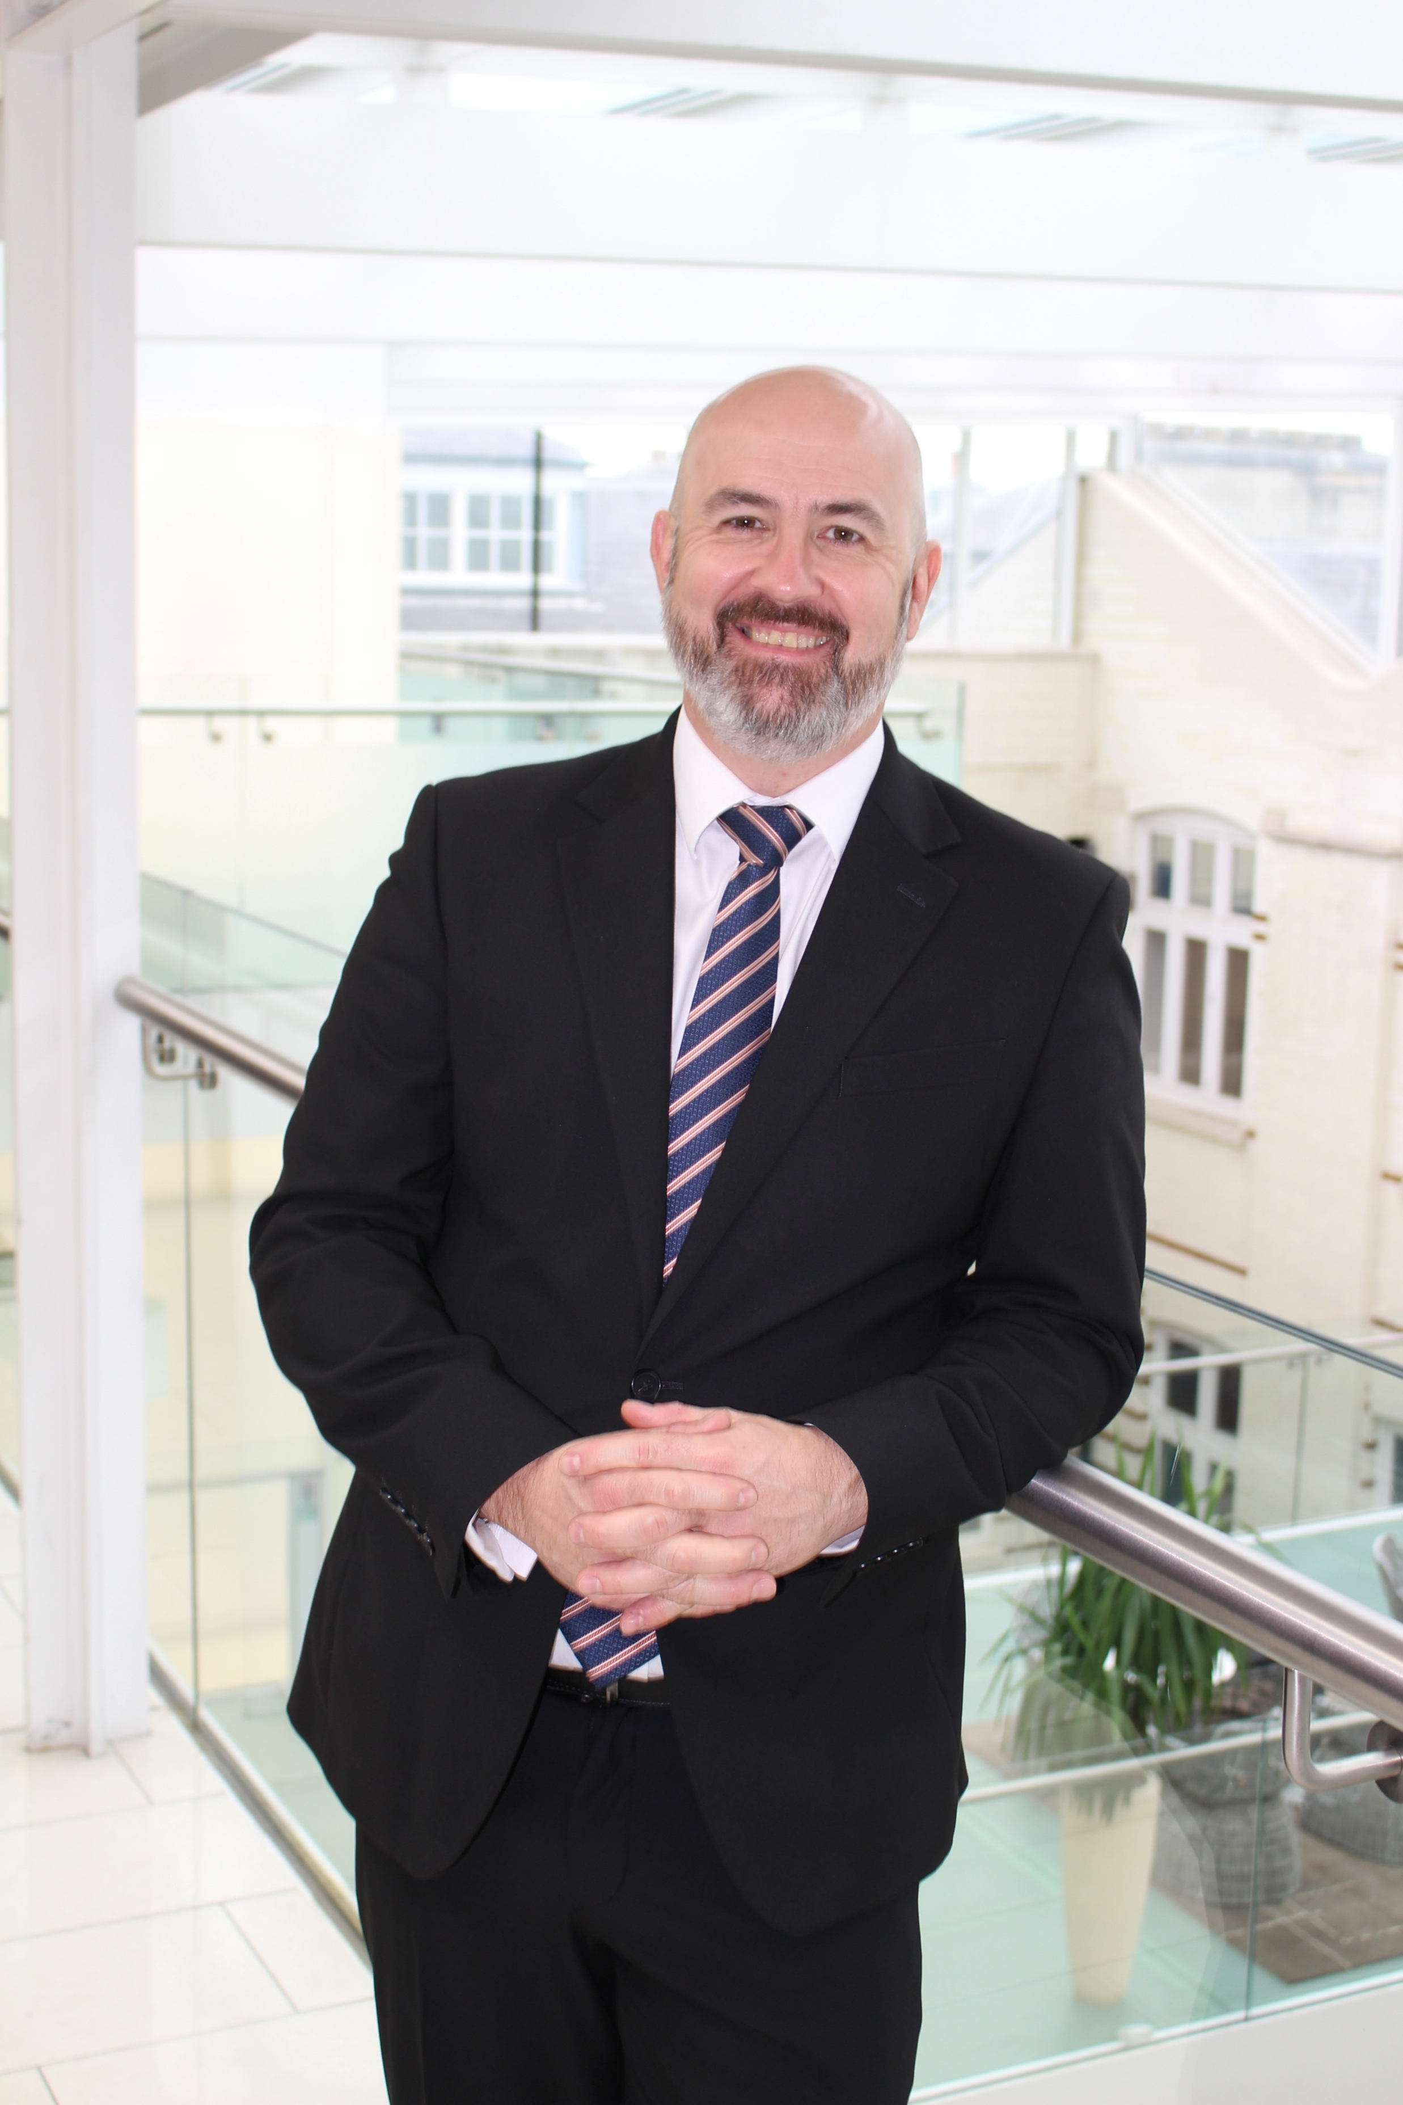

Welcome
Dear Candidate,
I am delighted that you are considering applying for the position of Director of Governance & Assurance, with the Gambling Commission.
We are a unique organisation with a vital purpose and are known internationally for our expertise and innovation. We regulate the largest online gambling industry in the world, with some 22.5 million consumers in Great Britain gambling to some extent every month. It is a complex and fast-moving industry with a heavy reliance on technology, and the work we do has real world impact on millions of people.
This is an exciting senior leadership role, with the opportunity to lead a critical function of talented and committed people and use your leadership expertise to make a real difference.
The Gambling Commission is constantly adapting to a rapidly changing landscape. Consumer behaviours in the gambling industry move fast, as do the industries it relies on such as sport, technology and entertainment. We are looking for a senior leader who will bring their systems thinking approach and sound judgement to this role, as well as excellent operational delivery skills to deliver improvement and modernisation at pace.
We also care deeply about our employer value proposition and building an inclusive and supportive culture. That is not just something we say. We are taking clear and practical steps to embed equity, diversity and inclusion into how we work every day. We know that diverse teams make better decisions, and we want everyone who joins us to feel they belong and can thrive, this is what makes working at the Gambling Commission so rewarding.
Now is a great time to join us. If you are motivated by the prospect of making a genuine impact and are ready to step into a senior leadership role to help shape the future of regulation in a global and dynamic industry, we would love to hear from you.
Thank you for your interest in this opportunity, I look forward to receiving your application.
Best wishes,
Andrew Rhodes
Chief Executive
Gambling Commission
Andrew Rhodes
Chief Executive Officer

Slide 3
About the Gambling Commission
Set up under the Gambling Act 2005, the Gambling Commission is a world-leading regulator committed to protecting the public from the potential harms of gambling. Our mission is clear: to keep crime out of gambling, protect children and vulnerable individuals, and ensure that the industry operates in a fair and transparent way.
We collaborate closely with the legal system, public health services, community organisations, and the industry itself to safeguard the interests of millions of people across Great Britain. With over 22.5 million adults regularly engaging in gambling and a market worth more than £15 billion in gross revenue annually, we oversee one of the largest and most complex regulated gambling industries in the world, much of which is driven by multinational operators and powered by fast-evolving technology and data.
At the heart of the Commission’s work is operational excellence. The Operations Directorate has 130 staff and key outputs include licensing operators, monitoring compliance, gathering intelligence and addressing high impact cases such match-fixing and political event betting. Nearly half of our organisation is focused on these critical functions, including anti-money laundering efforts and investigating the sources of funds, making our work both challenging and impactful.
The Gambling Commission also prides itself on being a values-led and rewarding place to work. Our Great Place to Work score has risen significantly, from 55% to 72%, with a strong Glassdoor rating of 4.2. We’re home to experts in data, research, and regulation, and the Gambling Commission provides the opportunity to translate deep insight into real-world outcomes.
For someone seeking a high-profile, purpose-driven role at the forefront of regulation, innovation, and public protection, the Gambling Commission offers a unique and highly fulfilling environment, where you can truly make your mark.
Read our corporate strategy 2024 - 2027 - https://www.gamblingcommission.gov.uk/about-us/guide/corporate-strategy-2024-to-2027
Read our business plan and budget - https://www.gamblingcommission.gov.uk/about-us/guide/business-plan-and-budget-2025-to-2026

Slide 4
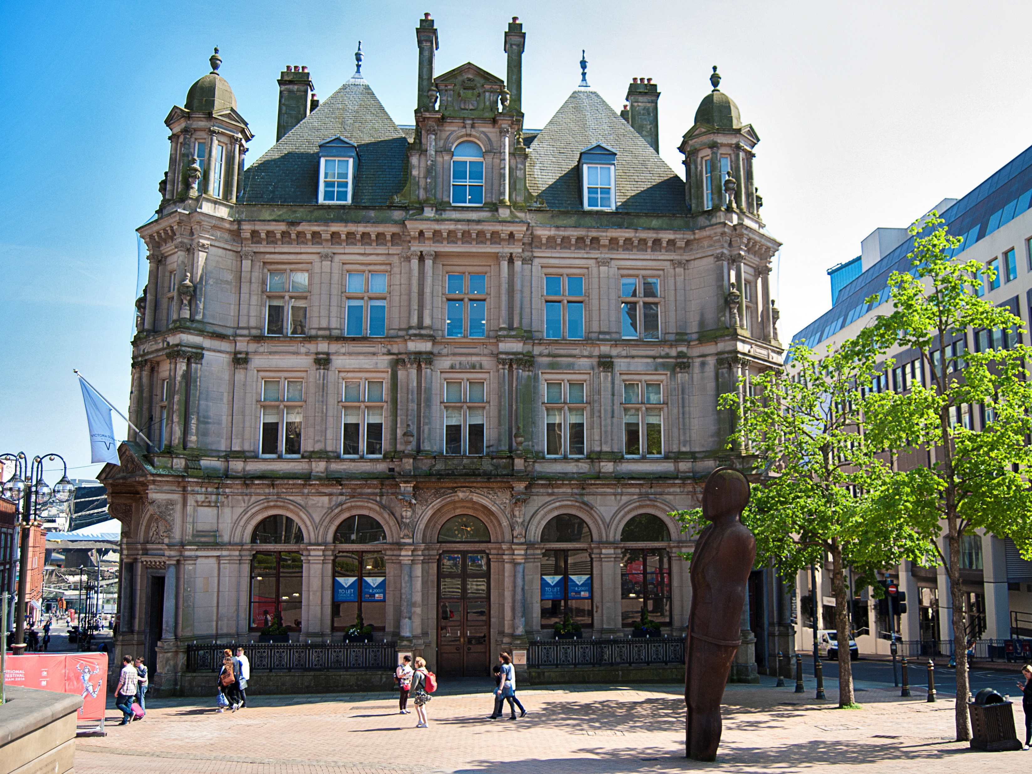

Slide 5
The Opportunity
12 month Fixed-Term Contract – Birmingham
Up to £97,000
The Gambling Commission is internationally recognised for its expertise, independence and innovation, and it is our purpose that truly brings our work to life. We regulate a dynamic, multi billion pound industry shaped by sport, technology and rapidly evolving consumer behaviour. The decisions we make directly influence how millions of people experience gambling across the country, and our regulatory powers play a crucial role in ensuring that this significant sector operates safely, fairly and with integrity. As we enter a period of organisational change and renewed strategic focus, we are seeking a Director of Governance who can bring clarity, confidence and connection to a defining year for the Commission.
The role
As Director of Governance & Assurance, you will be at the centre of how the Commission functions and how we uphold our responsibilities to the public. You will lead our governance, risk, assurance and information management teams, working closely with the Chief Executive, Executive Team and Board to support strong decision making and ensure good governance is lived across the organisation.
Your remit will be broad and influential. The Board and its Committees will rely on you to provide the insight and assurance needed for effective decision making. A mature, proactive risk culture will continue to develop under your leadership, strengthening how emerging issues are identified, understood and addressed. You will also oversee the systems and frameworks that ensure information is managed with the rigour, responsibility and transparency expected of a trusted regulator.
You’ll also provide leadership on conduct and ethical standards, overseeing whistleblowing, FOI, data protection and organisational integrity. This role offers a central hand in key organisational shifts - from preparing for a new Chair and Board members, to guiding colleagues through evolving expectations and new ways of working.
What you’ll bring
We’re looking for a leader who combines expertise with humanity - someone who understands the technical demands of governance but also the importance of relationships, influence and thoughtful leadership.
You’ll bring senior governance experience from the public or third sector, a sophisticated understanding of risk and assurance, and the confidence to operate with pace and clarity in a complex environment. You’ll be skilled in advising senior leaders with nuance and diplomacy and offer sound judgement in moments of complexity.
Experience in information and records management is essential, and familiarity with internal audit, Board recruitment or induction, or previous DPO responsibilities would be an advantage. Most importantly, you will bring gravitas, empathy and the ability to build trust quickly — helping teams to thrive and supporting colleagues through sustained organisational change.
Continued overleaf….

Slide 6
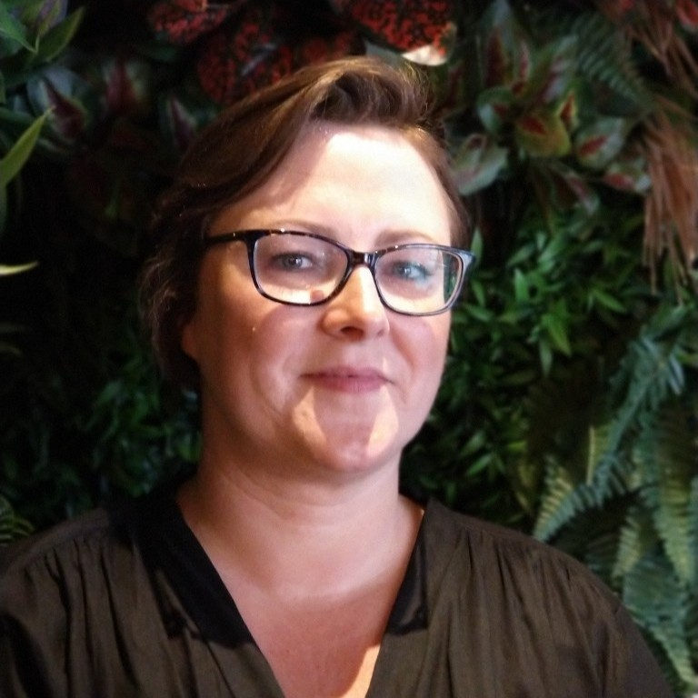
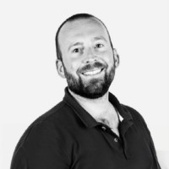
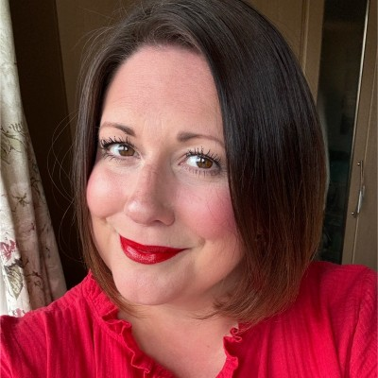
The Opportunity
Why join us?
The Commission is a place where colleagues feel genuinely connected to the work they do. Our strong 4.1 Glassdoor rating reflects the pride shared across our c.400 people and a culture built on openness, curiosity and collaboration. Colleagues are supported, trusted and encouraged to thrive and our flexible approach to working is shaped with their wellbeing firmly in mind.
We are also an organisation with a clear sense of direction. Decisions here carry weight, and your leadership would help shape discussions that influence how we operate and how we respond to a fast changing regulatory environment. You’ll be joining a community of talented, committed colleagues who care about doing the right thing and who value thoughtful, constructive partnership.
If this role feels like the right next step for you, we would be delighted to receive your application. It’s an opportunity to bring your leadership into an organisation that listens, evolves and values the contribution of its people. We hope you’ll consider joining us at such an important moment in our journey.
Where a candidate with a declared disability meets the minimum essential criteria for a role, they will automatically be invited for an interview. The Commission is committed to the Disability Confident Scheme and encourages applications from disabled people.
Closing date for applications:
Midnight, Sunday 22nd February 2026
For a confidential discussion contact our recruitment partner:
Kelly Ridley
on 07709 512415 or email: kelly.ridley@penna.com
James Miller
on 07701 233159 or email: james.miller@penna.com
Rachael Morris
on 07840 711217 or email: rachael.morris@penna.com

Slide 7
Job Description
Job Title: Director of Governance & Assurance
Line Manager: CEO
Department: Executive
Location: Birmingham
Flexible Working: Full time Contract: Temporary
Key Responsibilities
Lead the Governance Team, ensuring efficient and effective operation for the Commission, including oversight of whistleblowing arrangements, organisational conduct frameworks (such as declarations of interest and gifts and hospitality), and effective engagement with Internal Audit.
Development and continuous improvement of the governance, risk and assurance and information management and complaints frameworks and practices, including ensuring robust handling of complaints and concerns, and alignment with best practice in transparency and accountability.
Ensure the Board operates within the principles of code for government functions, and that relevant statutory, regulatory and sponsor department expectations are met.
Adviser to Board and Executive team on complex governance issues to comply with statutory obligations, government requirements and best practice, including the management of conduct, conflicts of interest and significant governance risks.
Building and maintaining influential relationships with senior stakeholders in the Commission, particularly with the Executive team and the Board, and externally with DCMS on governance matters.
Leading the annual effectiveness review of Board and Committees in line with corporate governance framework and proposing and overseeing ongoing support and development, drawing on internal and external assurance and feedback where appropriate.
Lead the risk and assurance team to continuously improve the Commission’s risk management framework and policies. To assess and prioritise current and emerging risks, providing reports on risk exposure, trends and mitigation, and ensuring effective coordination with Internal Audit and other assurance providers.
Support the delivery of the Corporate Strategy and help to create a great place to work.
You will also assume the role of Data Protection Officer, with accountability for ensuring compliance with data protection legislation and advising the organisation on related risks and obligations.
Job Purpose
The Gambling Commission (the Commission) Director of Governance & Assurance is responsible for leading the delivery and continuous improvement of the Commission’s governance, risk and assurance, information management and complaints framework and practices. Ensuring robust systems are in place to support effective decision-making, management of risk, transparency and accountability.
Leading a small team of experts to collaborate across the Commission, Board and wider government to embed a strong governance, risk and assurance culture. This role will play a critical role in maintaining the integrity and effectiveness of the Commission Board, Committees and Executive team. Providing expert advice and guidance to oversee management of all governance forums.
This role is on the National Lottery prohibited list.
The above does not constitute an exhaustive list of duties. The post holder may be required to perform any reasonable tasks commensurate with the level of responsibility at the request of their Manager.

Slide 8
Person Specification
Essential | Desirable
Proven experience of leading a corporate governance function ideally in a government or public sector setting, including working with Boards and Executive teams on complex governance matters. | Experience of working with Government function handbook and functional standards
Experience of Records and Information Management | Internal Audit Experience
Advanced understanding of risk and assurance requirements at a senior level. | Previous experience working as a Data Protection Officer
Sound judgement and highly developed diplomacy skills with experience of working with sensitive and confidential information. | Experience of supporting and managing portfolio transitions arising from organisational change, with the ability to operate effectively in ambiguous environments
Strong people leaderships experience with the ability to lead by example and drive a culture of forward- thinking and continuous improvement. | Experience in Recruitment and Induction of Board Members
Embeds inclusion in business strategy, policy and organisational culture.
An excellent communicator, with the ability to adapt style depending on the audience.
Able to deliver at pace and manage competing priorities.
Highly collaborative with strong interpersonal skills and the ability to influence and persuade senior internal and external stakeholders.

Slide 9

Director of Governance & Assurance
Head of Secretariat
Head of Information Compliance
Senior Manager Governance and Risk
Lived Experience Co-Ordinator (0.8 FTE)
Records Manager
Information Governance Manager
Information Governance Manager
Governance Manager
Vacant
Governance Manager
Risk and Assurance Manager
Stakeholder Governance Manager (0.8 FTE)
Governance Officer
Governance Manager and PA to Chair
Governance Administrator
Risk Analyst
(FTC)
Contact Centre Manager
Contact Centre Manager
Contact Team Senior Adviser
Contact Team Adviser
Contact Team Adviser
Contact Team Adviser
Contact Team Adviser
Contact Team Senior Adviser
Contact Team Adviser
Organisational Structure can be found here

Slide 10
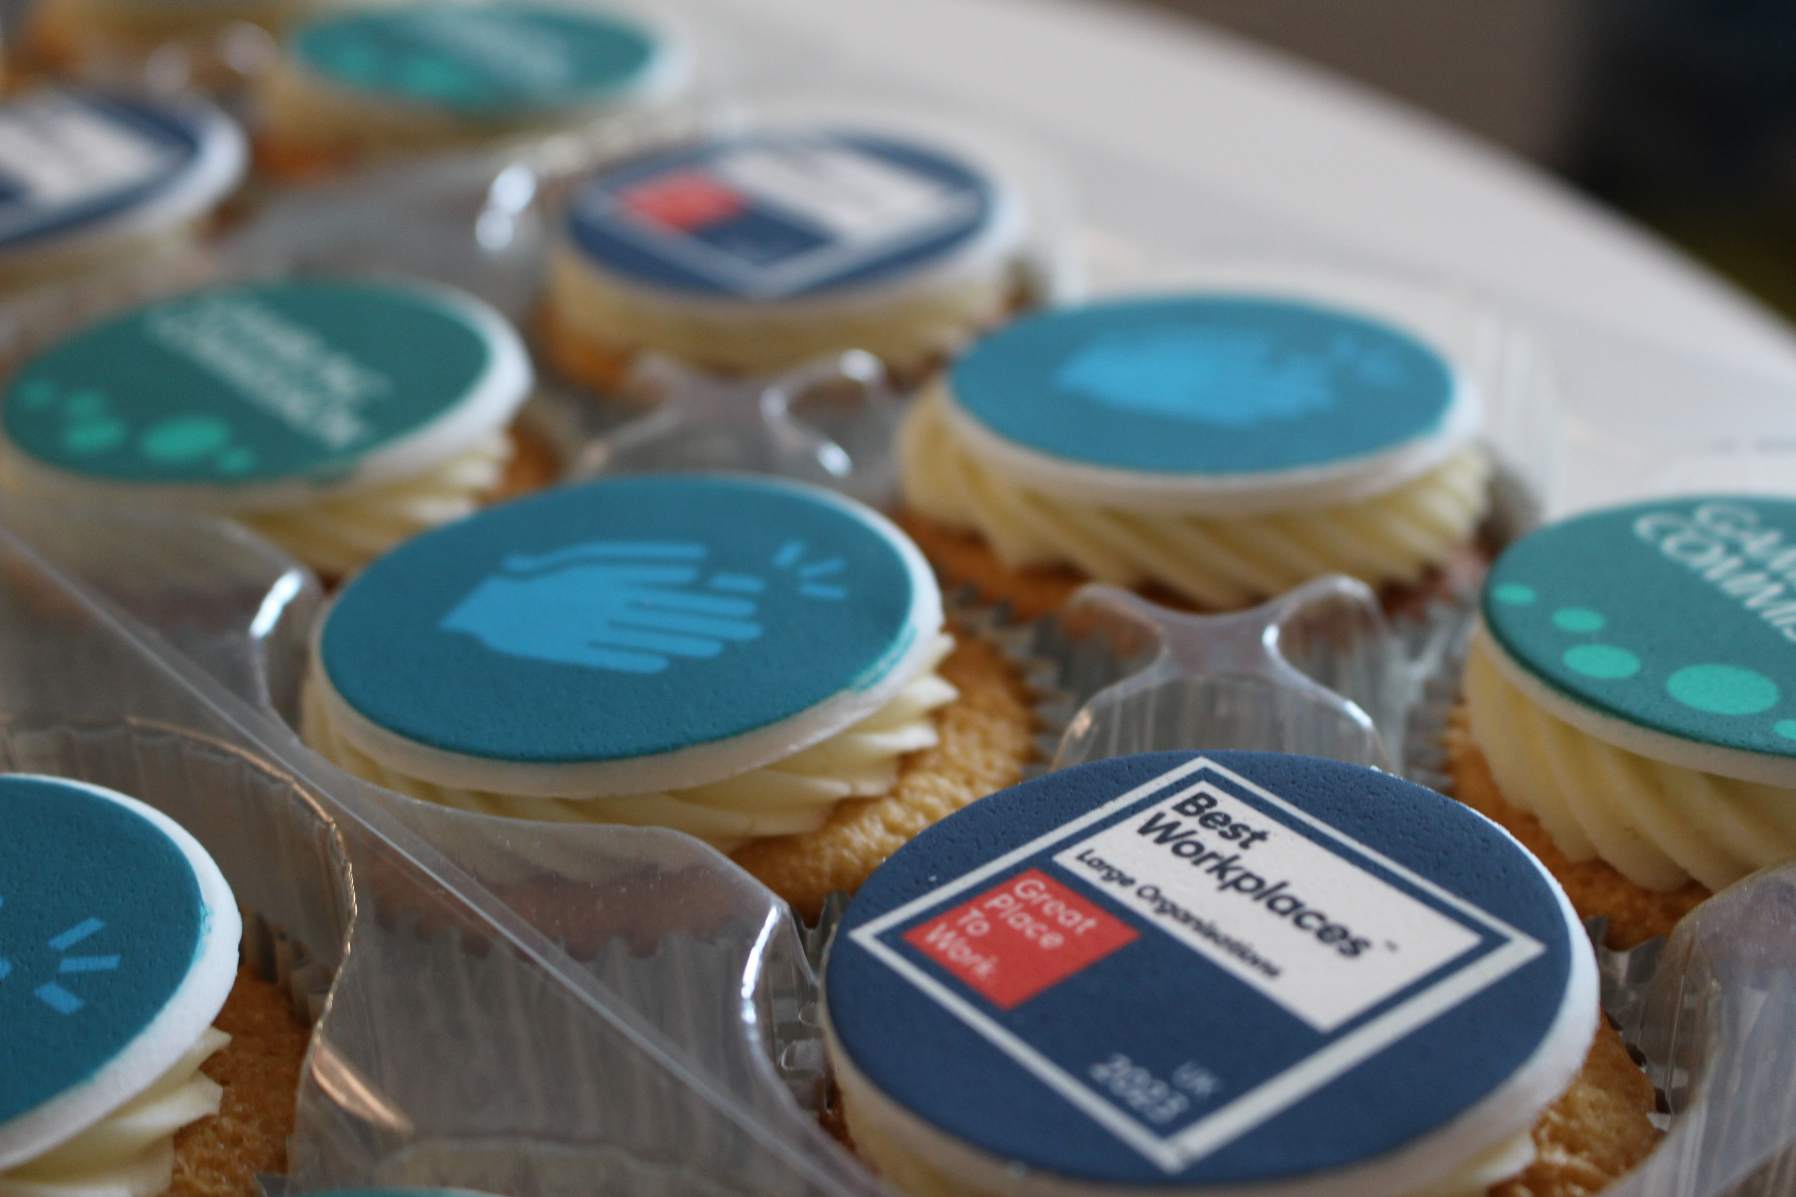

Slide 11
How to Apply
This guidance contains important information to help with your application:
Please apply by submitting a CV and Cover Letter (no more than two sides of A4 in length per document aligned to the person specification). Please also include your contact details.
Please ensure your full employment history is outlined in your CV; where there are essential criteria, competencies and/or qualifications please make clear how you meet these. We may wish to verify this information during the recruitment process.
Please provide the details of two referees. Note that we will only approach referees for candidates proceeding to final selection and only with your permission. Please clearly indicate whether we can approach each referee before the selection date.
Please share with us in your Supporting Statement the values and behaviours that you bring to your leadership, and how you will transfer your skills and experience into this role.
Please complete the Equal Opportunities Monitoring Form when you upload your details via the Penna website.
Please upload your application by the closing date – no applications will be accepted once the role has closed.
Following long-listing, you will be contacted directly by a Penna consultant to update you on the status of your application.
Where a candidate with a declared disability meets the minimum essential criteria for a role, they will automatically be invited for an interview. The Commission is committed to the Disability Confident Scheme and encourages applications from disabled people.
We’re committed to making our recruitment practices barrier-free and as accessible as possible for everyone. This includes making adjustments or changes for disabled people, neurodiverse people or people with long-term health conditions. If you would like us to consider doing anything differently during the application, interview, or assessment process, including providing information in an alternative format, please contact Penna.
To apply for this role, please visit the following link to upload your CV and Cover Letter: https://penna.com/jobs
Date | Stage
22nd February 26 | Application Deadline
25th February 26 | Shortlist Meeting (candidates are not required to attend)
W/C 2nd March 26 | Psychometric Assessments
W/C 9th March 26 | Chat with the Chair of the Board – Charles Counsell
16th March 26 | Final Interviews (Victoria Square House, Birmingham)

Slide 12
Equality, Diversity and Inclusion at Gambling Commission -
What it means for you
At the Gambling Commission we want everyone to feel like they belong. This is the core of our commitment to equality, diversity and inclusion, and is a key part of what we offer anyone who joins the organisation. We believe people do their best work when they feel supported, respected and free to be themselves. Our approach to inclusion is something we build together every day, it is part of who we are and how we work.
Equality, Diversity and Inclusion at Gambling Commission - what it means for you Inclusion is part of how we work
Our approach to diversity and inclusion is not just about doing the right thing. It’s about creating a workplace where everyone feels heard and valued. Whether you are just starting with us or have been here for a while, we want you to feel:
Recognised for who you are and what you bring - 87% of employees agree the Gambling Commission values all people regardless of individual differences
Encouraged and supported to grow in your role
Connected to people who care about your wellbeing
Treated fairly and with respect, always
To help make that happen, we’ve put inclusive practices in place across the Commission. For example, we use diverse panels in recruitment and regularly review our processes to make sure they are fair, open and accessible.
We have a number of colleague-led networks that play a big role in shaping our culture. These include groups for Pride, Neurodiversity, Menopause, Parents and Carers, Black colleagues and South Asian colleagues. They offer connection, support and a space for honest conversations.
Our D&I Strategy gives everyone a chance to get involved and feel confident playing their part in making the Commission a better place to work.
Inclusion is built into everything we offer.
Our commitment to inclusion shows up across all aspects of life at the Commission, it is part of what we call Our Deal – the experience of working here. 89% of employees agree the Commission is committed to creating an inclusive workplace. This includes:
Flexible working – The freedom to work in ways that suit your life, with trust at the heart of how we work together
Supportive relationships – A culture where people look out for each other and where your manager and team are there for you
Learning and development – Opportunities to grow, explore new areas and shape your own career path
Wellbeing support – Help when you need it, with benefits and services that support your mental, physical and financial health
Meaningful work – A sense of purpose and pride in what we do together to make gambling safer and fairer for everyone

Slide 13
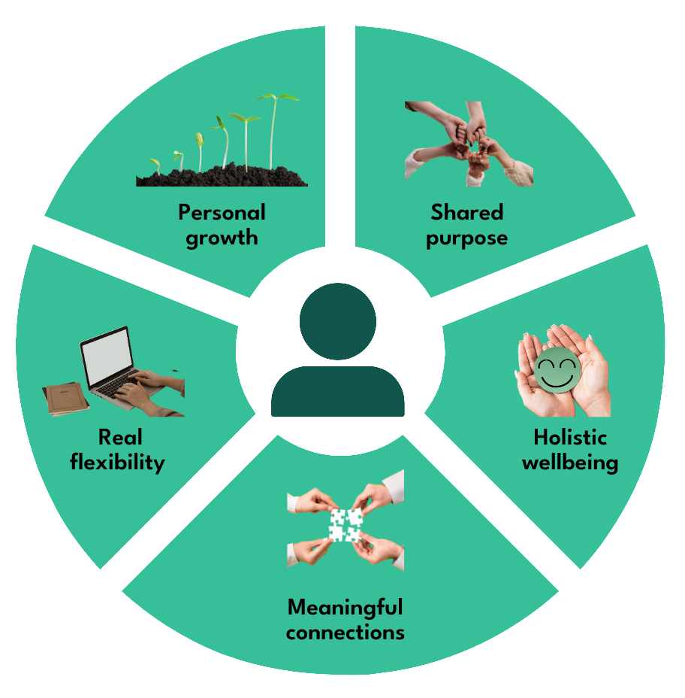
Our Deal: What You Can Expect From Us
At the Commission, Our Deal is our promise to you, a clear statement of what it feels like to work here and how we support you to thrive. It brings together our culture, values, benefits and the experience you’ll have as part of our team. Our Deal is built around 5 key pillars
Meaningful Connections
We’re building a workplace where you can be yourself, feel valued, and form genuine connections. Our diversity and inclusion work, leadership development, and community focus ensure everyone belongs.
Shared Purpose
Your work has impact. We offer opportunities to engage with the issues that matter to you — organisational, societal, cultural and environmental.
Holistic Wellbeing
Your wellbeing comes first. With recognition, fair compensation, and wide‑ranging wellbeing support, we help you feel at your best inside and outside of work.
Real Flexibility
We empower you to work in a way that fits your life through hybrid working, flexible arrangements and a central Birmingham office.
Personal Growth
We invest in your development through learning opportunities, career pathways, equal access to progression and support to build your skills for the future.
How We Deliver Our Deal
We continuously invest in improving our people experience through:
Pay and reward projects
Learning & Development offer
Management and leadership development
A clear competency framework
Comprehensive wellbeing initiatives
A strong diversity and inclusion strategy & framework
Benefits
Leave
26 days annual leave, rising to 29 after two years
Option to buy up to 5 additional days
Pension
Generous 28.97% employer contribution
Low member contributions
Guaranteed inflation‑proof pension
Life assurance and dependants’ benefits
Enhanced Leave Allowances
Up to 6 months full pay + 6 months half pay for sickness (post‑probation)
Enhanced maternity, paternity, adoption, shared parental and neonatal leave
Paid leave for emergencies, compassionate reasons, jury service, public duties and more
Additional Benefits
24/7 Employee Assistance Programme with counselling
Colleague recognition scheme
Discounts, vouchers, financial wellbeing tools and health plans
SmartTech interest‑free purchase scheme
Cycle to Work and season ticket loans
Civil Service Sports Club membership
Mental Health First Aiders & Occupational Health
Flexible working options
Learning & Development
Access to our Learning Zone e‑platform
Regular internal training

Slide 14
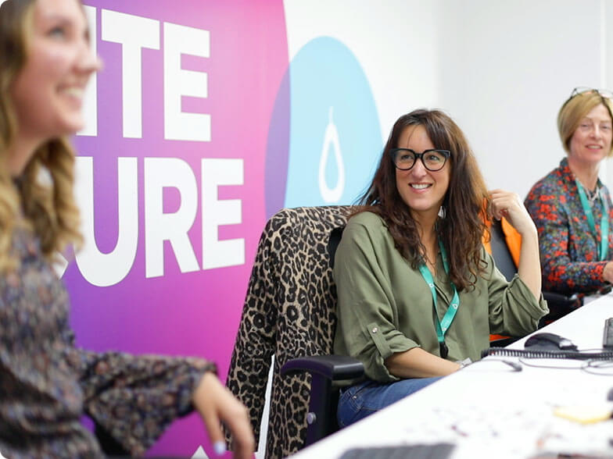

Penna Executive Search
Inclusive Leadership …Redefined!
At Penna, we specialise in connecting outstanding professionals to senior leadership roles that shape the future of local government.
Our decades of experience working with local authorities set us apart. We understand the demands of political leadership, the importance of corporate plans, and the skills needed to navigate complex, challenging environments.
We work with integrity, imagination, and determination to ensure every placement is the right fit. Whether you are looking for leaders who can deliver major change initiatives, champion high performance cultures, or build stronger partnerships with communities and stakeholders, our specialist team will help you find the talent who can turn vision into reality.
At Penna, we want to build leadership that delivers stronger, fairer, and more sustainable communities.
www.penna.com

